Slide 1

Take Control of Your
Digital Outreach
with Grok Bot
The Zúme advertising case study
01
Notes:
TIME 0:00–0:45. Welcome. This is our case study of using AI agents to operate advertising and landing pages. The practical goal is to shorten the time between learning and action. Plan: opening slides followed by the live demonstration and audience questions.
Design reference: keeping-ai-consistent-with-illustrations-v26.pptx, supplied by presenter.

Slide 2
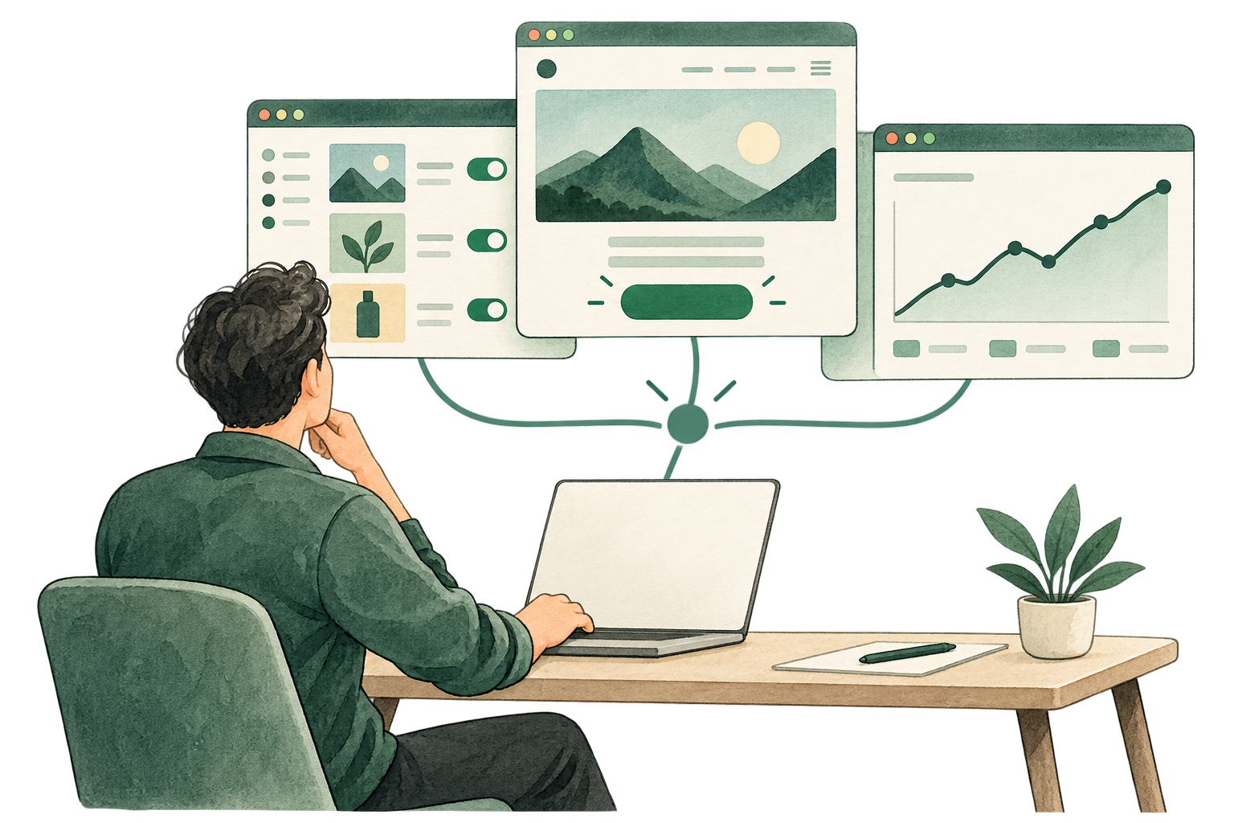
Small teams. High impact
Grok Bot as your advertising
strategy and implementation team.
Campaign strategy, ad management,
landing pages, and measurement.
Your team sets the direction.
02
Notes:
TIME 0:45–2:00. The seminar is for small teams that want high impact. Frame Grok Bot as an advertising strategy and implementation team they can direct: campaign planning, ad management, landing-page publishing, and performance review. Explain that a small ministry team can coordinate this work through an agent connected to its actual tools. The human provides ministry direction, context, and decisions. Introduce the Zúme case study as the concrete example that follows. Small-team illustration generated for this seminar with the built-in image generation tool.
Design reference: keeping-ai-consistent-with-illustrations-v26.pptx, supplied by presenter.

Slide 3
More sign-ups at a lower cost
Zúme Training Google Ads
+167%
−80%
−46%
Recorded sign-ups
Cost per sign-up
Weekly spend
88 to 235
$9.99 to $2.04
$879.32 to $479.07
Sep 14–20 vs Sep 28–Oct 4, 2026. Sign-up = Google Ads-attributed account creation.
03
Notes:
TIME 2:00–3:00. Weekly sign-ups increased from 88 to 235, a 167.0% increase. Weekly spending fell 45.5%. Cost per sign-up fell 79.6%. Describe these as observed results during the work, not a controlled estimate of AI’s causal impact. These are account creations, not verified training starts or completions. Source: zume-ads-month-report-2026-10-05.pdf, page 1, supplied by presenter. Google Ads account 5758578507. Completed days through Oct 4, 2026. No new live account query was performed for these slides.
Design reference: keeping-ai-consistent-with-illustrations-v26.pptx, supplied by presenter.

Slide 4
Three weeks of improving results
Recorded sign-ups
Cost per sign-up (USD)
Completed weeks in 2026. Source: Zúme Google Ads report, Oct 5.
04
Notes:
TIME 3:00–4:00. Follow the two charts together. Use Sep 14 as the baseline because sign-up counting changed around that date. The supplied full chart includes an earlier $159.20 point that is not directly comparable. These charts use the report’s counted sign-up series and cost per counted sign-up. Source: zume-ads-month-report-2026-10-05.pdf, page 1, supplied by presenter. Google Ads account 5758578507. Completed days through Oct 4, 2026. No new live account query was performed for these slides.
Design reference: keeping-ai-consistent-with-illustrations-v26.pptx, supplied by presenter.

Slide 5
Session goal
See what we’re doing.
Learn how you can do it.
01 Walk through the Zúme case study
02 Build this workflow for your team
05
Notes:
Introduce the two parts of the session: first, show the Zúme case study and demonstrate what we are doing with the connected tools. Then explain how participants can set up the same kind of workflow for their own teams.
Design reference: keeping-ai-consistent-with-illustrations-v26.pptx, supplied by presenter.

Slide 6



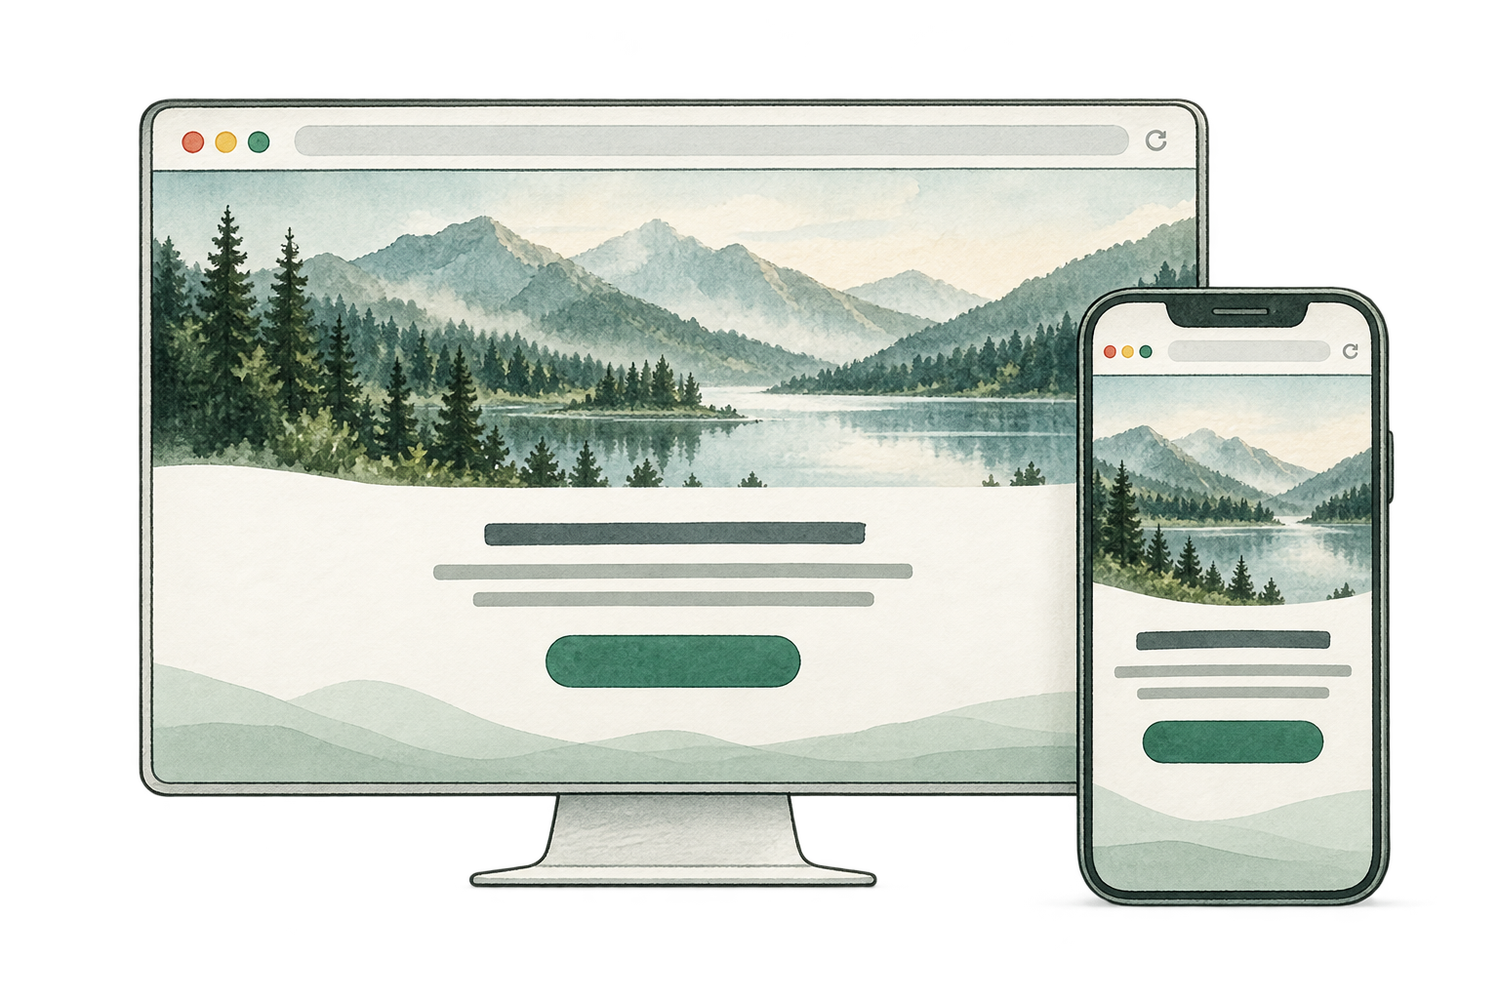
The tools behind our ad system
Grok Bot
Cursor
Ryze AI
Publishing MCP
Direct the work
Build and update
Connect ads and analytics
Publish landing pages
06
Notes:
Introduce the four elements used in our advertising system: Grok Bot, Cursor, Ryze AI, and a publishing MCP for the landing-page site. These role descriptions summarize our workflow. Logo sources: Grok Bot installed application icon, /Applications/Grok Bot.app/Contents/Resources/icon.icns; https://cursor.com/marketing-static/icon-192x192-light.png ; https://www.get-ryze.ai/main-logo-sun-2.webp . Product references: https://x.ai/bot ; https://cursor.com ; https://www.get-ryze.ai . Publishing MCP uses the previously generated landing-page illustration, not a product logo.
Design reference: keeping-ai-consistent-with-illustrations-v26.pptx, supplied by presenter.

Slide 7
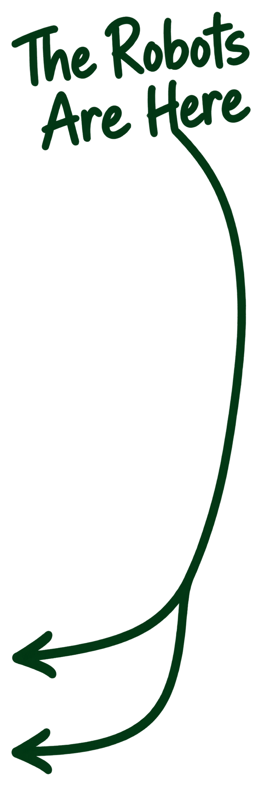
How we got here
From chat to autonomous agents
2024
Code completion
2025
Full coding chat
Early 2026
Claude Code breakout. OpenClaw revolution.
April
Codex becomes the do anything app.
August
Grok Bot launches in connection with Cursor.
September
Meta launches Muse. ChatGPT launches Dot.
07
Notes:
Orientation: spend about one minute on this progression. The 2025 and early-2026 descriptions are the presenter’s interpretation of industry momentum, not precise launch dates. Claude Code was already available before 2026. OpenClaw’s introduction was dated January 29. April refers to Codex expanding into broader work, not the initial desktop app launch. The April 16 changelog includes projectless research, writing, planning, analysis, browser and computer use. Grok Bot launched August 11 with Cursor plan access. Cursor announced its completed SpaceX acquisition August 14. Meta introduced Muse September 8. The presenter’s phrase about Claude coming is an outlook, with no future release date verified, so it is not shown as a dated milestone. Sources: https://www.anthropic.com/news/introducing-anthropic-labs ; https://openclaw.ai/blog ; https://learn.chatgpt.com/docs/changelog (April 16, 2026) ; https://x.ai/news/introducing-grok-bot ; https://prod.cursor.com/blog/joining-spacex ; https://about.fb.com/news/2026/09/introducing-muse-personal-ai-agent/ .
Design reference: keeping-ai-consistent-with-illustrations-v26.pptx, supplied by presenter.

Slide 8
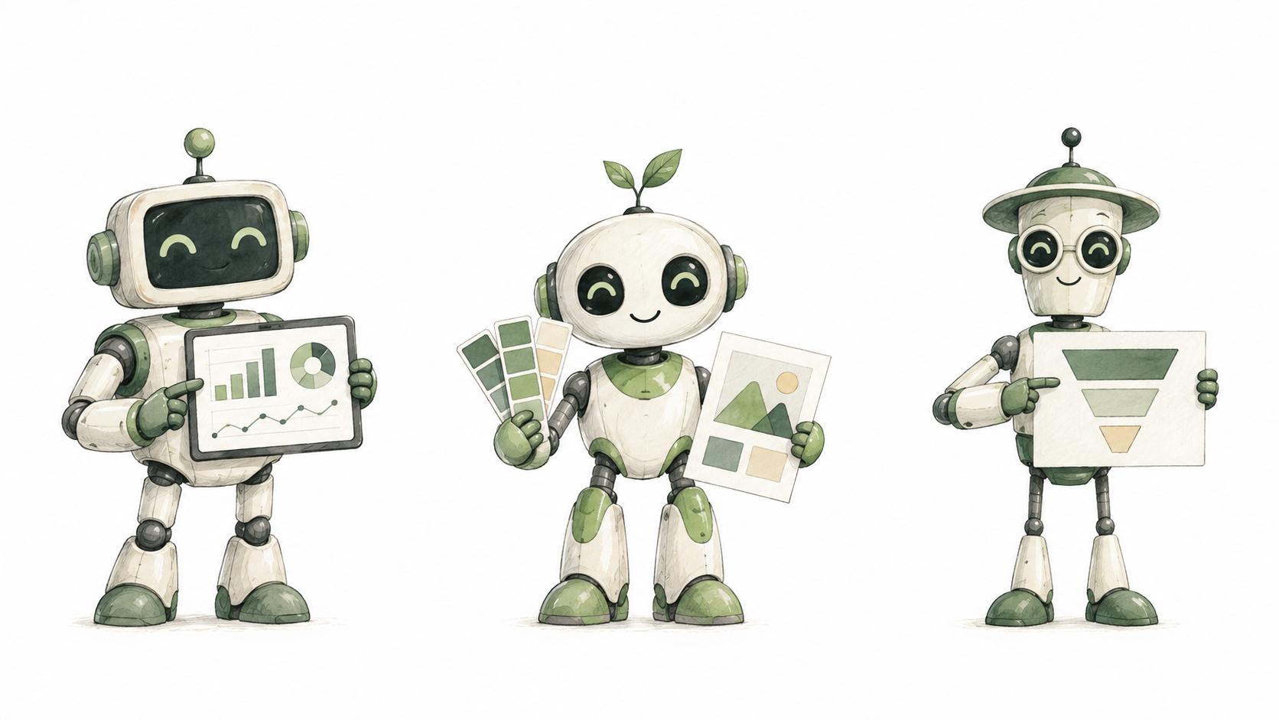
Introducing Grok Bot’s...
Zúme Ad Team
Ad Bot
Brand Manager Bot
Funnel Expert Bot
08
Notes:
Pause after the session goal and switch to Grok Bot for a short demonstration of a concrete task. Show the request, the agent working with a connected tool, and the resulting output. Return to the tools introduction. Three robots created with the built-in image-generation tool in pencil and watercolor style.
Design reference: keeping-ai-consistent-with-illustrations-v26.pptx, supplied by presenter.

Slide 9
Our outreach system
VISITOR JOURNEY
Ads
Landing pages
Registrations
Ad accounts
Landing-page site
Google Analytics
Publishing MCP
Cursor
Ryze AI
Ryze AI
Grok Bot
Human
09
Notes:
TIME 4:30–5:00. Start with the visitor journey across the top: ads lead to landing pages, then registrations. Ad accounts drive the ads. The landing-page site hosts the pages. Google Analytics tracks the whole funnel. The human sits below Grok Bot, directing and reviewing the work. Grok Bot connects straight upward through MCP to the landing-page site. Grok Bot reaches advertising accounts through Ryze AI, publishes landing pages through an MCP connection, and reads Google Analytics reports through Ryze AI. Ryze appears twice to keep the ad and analytics routes visually separate, but represents the same integration. Analytics read access does not by itself configure tracking. This diagram describes the presenter’s intended connected system, not a fresh verification of live account permissions. Sources: presenter instructions; https://www.get-ryze.ai/google-analytics-mcp ; https://www.get-ryze.ai/blog/connect-google-ads-meta-tiktok-ga4-search-console-shopify-claude-mcp .
Design reference: keeping-ai-consistent-with-illustrations-v26.pptx, supplied by presenter.

Slide 10
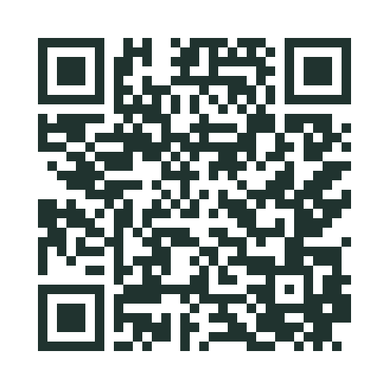
Step 1: Landing-page site
An MCP service connects agent and site
The connection lets agents create, update,
and publish on the website platform.
Reusable templates + Zúme’s voice
Define the layouts, brand, and messaging
the agents should use.
See a live landing page
Scan for the English
prayer-walking page.
10
Notes:
QR destination: https://zume.training/articles/prayer-walking-english . Published English landing record confirmed through Content MCP; public page returned HTTP 200 with the expected Prayer Walking title. The MCP service connects the agent to the website platform. The most important prerequisite was a publishing site connected to the AI agents so they could publish directly. As we developed and launched a new advertising campaign, we could publish its matching landing page immediately. We established reusable landing-page templates and gave the agents Zúme brand and messaging guidance: what to say, how to say it, and how the page should look. The agents populate these layouts with content specific to each ad, keeping the ad’s promise and the landing-page message aligned. Emphasize that this foundation enables the speed of the entire workflow.
Design reference: keeping-ai-consistent-with-illustrations-v26.pptx, supplied by presenter.

Slide 11
Step 2: Ad accounts
Ryze AI connects your agent to your advertising services.
Google Ads
Meta Ads
LinkedIn Ads
OpenAI Ads
Your agent
Ryze AI
Microsoft Ads
TikTok Ads
Snapchat Ads
Reddit Ads
Pinterest Ads
Thrad
11
Notes:
Ryze AI is the intermediary connecting the agent to advertising services, supporting campaign changes and performance reporting where the service and permissions allow. Services shown come from the presenter-supplied Ryze integrations screenshot: Google Ads, Meta Ads, LinkedIn Ads, OpenAI Ads, Microsoft Ads, TikTok Ads, Snapchat Ads, Reddit Ads, Pinterest Ads, and Thrad. The screenshot shows Google Ads and OpenAI Ads as connected; the other tiles offer Connect. The diagram illustrates available integrations, not a claim that all these accounts are connected or that every operation is supported.
Design reference: keeping-ai-consistent-with-illustrations-v26.pptx, supplied by presenter.

Slide 12

Step 3: Google Analytics
Google Ads tracking
Collect clicks, spend, and conversions
from your Google campaigns.
OpenAI Ads tracking
Collect campaign results and
conversion data from your ads.
Funnel tracking in
Google Analytics
Follow visitors from landing page
to registration and other key actions.
12
Notes:
This step is the data-collection foundation for knowing whether advertising is performing. Use Google Ads tracking, OpenAI Ads tracking, and website funnel events measured in Google Analytics. Review these sources together to understand campaign results and where visitors progress or drop out. Configure and verify the available conversion tracking for each advertising platform and the website events in Google Analytics. Do not imply that Google Analytics automatically receives all advertising-platform data or that every platform reports identical metrics. Retain the conceptual measurement illustration.
Design reference: keeping-ai-consistent-with-illustrations-v26.pptx, supplied by presenter.

Slide 13
Our outreach system
VISITOR JOURNEY
Ads
Landing pages
Registrations
Ad accounts
Landing-page site
Google Analytics
Publishing MCP
Cursor
Ryze AI
Ryze AI
Grok Bot
Human
13
Notes:
TIME 4:30–5:00. Start with the visitor journey across the top: ads lead to landing pages, then registrations. Ad accounts drive the ads. The landing-page site hosts the pages. Google Analytics tracks the whole funnel. The human sits below Grok Bot, directing and reviewing the work. Grok Bot connects straight upward through MCP to the landing-page site. Grok Bot reaches advertising accounts through Ryze AI, publishes landing pages through an MCP connection, and reads Google Analytics reports through Ryze AI. Ryze appears twice to keep the ad and analytics routes visually separate, but represents the same integration. Analytics read access does not by itself configure tracking. This diagram describes the presenter’s intended connected system, not a fresh verification of live account permissions. Sources: presenter instructions; https://www.get-ryze.ai/google-analytics-mcp ; https://www.get-ryze.ai/blog/connect-google-ads-meta-tiktok-ga4-search-console-shopify-claude-mcp .
Design reference: keeping-ai-consistent-with-illustrations-v26.pptx, supplied by presenter.

Slide 14
Train your bots
Build capability. Then expand responsibility.
01
Equip
Give them tools, access, templates,
brand guidance, and clear goals.
02
Assign reports + recommended actions
Ask what happened, what it means,
and what to do next. Review together.
03
Gradually delegate decisions
Start with small, defined decisions.
Expand autonomy as results earn trust.
14
Notes:
Introduce how to train the bots as a progression of responsibility. First equip them with the tools, account access, reusable templates, brand guidance, and goals they need. Next assign recurring reports that include interpretation and recommended actions; review their reasoning and give feedback. Then gradually assign autonomous decisions within a defined scope, beginning with small decisions and widening their responsibility as their results demonstrate reliability. Human judgment sets goals and determines how much authority to delegate.
Design reference: keeping-ai-consistent-with-illustrations-v26.pptx, supplied by presenter.

Slide 15
01 Equip
Give them tools, access, templates, brand guidance, and clear goals.
Ad Bot
Brand Manager Bot
Funnel Expert Bot
15
Notes:
Training stage: 01 Equip. Use the Zúme Ad Team to explain how this stage applies to Ad Bot, Brand Manager Bot, and Funnel Expert Bot.
Design reference: keeping-ai-consistent-with-illustrations-v26.pptx, supplied by presenter.

Slide 16
02 Assign reports + recommended actions
Ask what happened, what it means, and what to do next. Review together.
Ad Bot
Brand Manager Bot
Funnel Expert Bot
16
Notes:
Training stage: 02 Assign reports + recommended actions. Use the Zúme Ad Team to explain how this stage applies to Ad Bot, Brand Manager Bot, and Funnel Expert Bot.
Design reference: keeping-ai-consistent-with-illustrations-v26.pptx, supplied by presenter.

Slide 17
03 Gradually delegate decisions
Start with small, defined decisions. Expand autonomy as results earn trust.
Ad Bot
Brand Manager Bot
Funnel Expert Bot
17
Notes:
Training stage: 03 Gradually delegate decisions. Use the Zúme Ad Team to explain how this stage applies to Ad Bot, Brand Manager Bot, and Funnel Expert Bot.
Design reference: keeping-ai-consistent-with-illustrations-v26.pptx, supplied by presenter.

Slide 18
Recommended next steps
Build this workflow
for your team.
Start with the tools, connections, and working habits
that fit your team.
18
Notes:
Transition from the Zúme case study to the recommended approach for participants. Introduce how they can build this workflow for their own team: choose the tools, connect their publishing and advertising systems, establish measurement, and develop the bots through equipping, reports with recommended actions, and gradual delegation. Use the following section to explain the recommended setup.
Design reference: keeping-ai-consistent-with-illustrations-v26.pptx, supplied by presenter.

Slide 19
We recommend
VISITOR JOURNEY
Ads
Landing pages
Registrations
Ad accounts
ChatGPT Sites
Google Analytics
Ryze AI
Ryze AI
ChatGPT Dot
Human
19
Notes:
Recommended workflow diagram supplied by the presenter: ChatGPT Dot connects directly to ChatGPT Sites for landing pages, and through Ryze AI to ad accounts and Google Analytics. The human directs the agent. This is a proposed setup, not a verification of live integrations or available permissions.
Design reference: keeping-ai-consistent-with-illustrations-v26.pptx, supplied by presenter.

Slide 20
Build your site + tracking
01
Open ChatGPT + use the starter prompt
Create a site for multiple landing pages, with
reusable templates, design, and brand guidance.
02
Set up Google Analytics
Sign in and create your property. Have ChatGPT
add the sitewide tag and verify your key events.
03
Set up Google Ads conversion tracking
Sign in and define your conversion. Have ChatGPT
configure the tracking and verify it records correctly.
20
Notes:
Walk through the proposed setup. Open ChatGPT and provide the starter prompt that will be supplied with the seminar; the prompt should establish a reusable landing-page site, design guidance, brand context, and templates supporting multiple pages. Have the agent open Google Analytics in the browser; the participant signs in and completes account/property setup as needed. Configure the sitewide Google tag and key events, then verify measurement on the published site. Next open Google Ads; the participant signs in and defines the desired conversion action. Configure its measurement using the appropriate Google tag destination, event setup, or Analytics import. A second duplicate base tag is not necessarily required, and a tag alone does not define a meaningful conversion. Verify the chosen conversion rather than treating installation alone as success. This is the presenter’s proposed participant workflow; no accounts or sites are created by this slide edit.
Design reference: keeping-ai-consistent-with-illustrations-v26.pptx, supplied by presenter.

Slide 21
Connect your tools + start the daily rhythm
04
Connect ChatGPT to Ryze AI
Register with Ryze AI, authorize your ad accounts
and analytics, and connect them to ChatGPT.
05
Train Dot to report every day
Ask for results, wasted spend, funnel drop-offs,
and recommended actions in one daily report.
06
Review, act, and gradually delegate
Review recommendations, approve changes,
and build toward daily ad management and analysis.
21
Notes:
Continue the proposed participant workflow: open Ryze AI, register or sign in, authorize the ad and analytics accounts, and complete the supported ChatGPT connection. The participant completes authentication and account authorization. Verify that the agent can read the intended accounts and determine which campaign changes its permissions support. Then establish a daily reporting task with a clear schedule, metrics, comparison period, and recommended actions. Review the reports, give feedback, and authorize changes. Expand autonomous decision making gradually within an explicit scope. This begins the operating rhythm of the connected advertising system; it is not a claim that every connection or scheduled task works automatically without setup.
Design reference: keeping-ai-consistent-with-illustrations-v26.pptx, supplied by presenter.

Slide 22
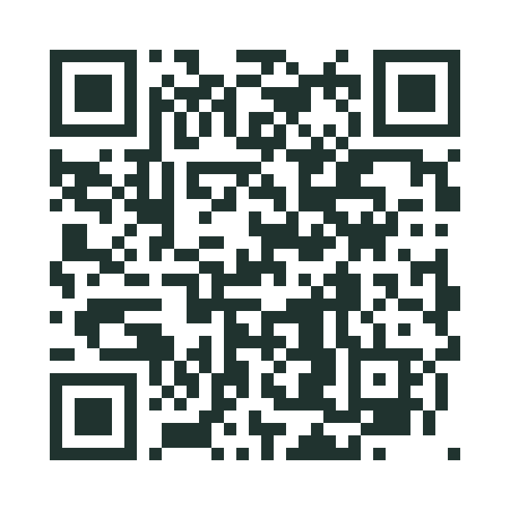
Build your AI ad team
Your next step starts here.
The step-by-step setup guide
Ready-to-use ChatGPT prompts
Printable workbook + checklist
Scan for the guide + downloads
zume-ad-team-guide.chrischasm.chatgpt.site
22
Notes:
QR destination: https://zume-ad-team-guide.chrischasm.chatgpt.site . The companion site contains the six-stage participant workflow, copyable and downloadable prompts, the setup workbook PDF, the quickstart checklist PDF, and seminar slides. Invite participants to scan now and work through one stage at a time.
Design reference: keeping-ai-consistent-with-illustrations-v26.pptx, supplied by presenter.

